Slide 1
Ear Nose Throat
Examination Techniques
Paul M Paddle MBBS(hons), FRACS, MPH, PGrad Dip Anat
ENT, Head & Neck Surgeon, Laryngologist

Slide 2

Outline

Slide 3
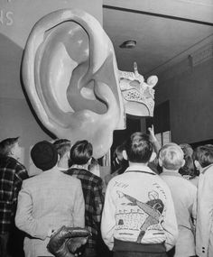
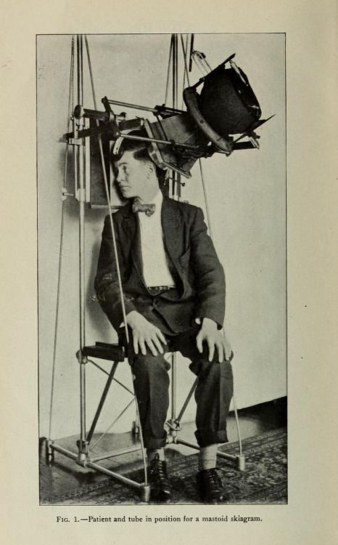
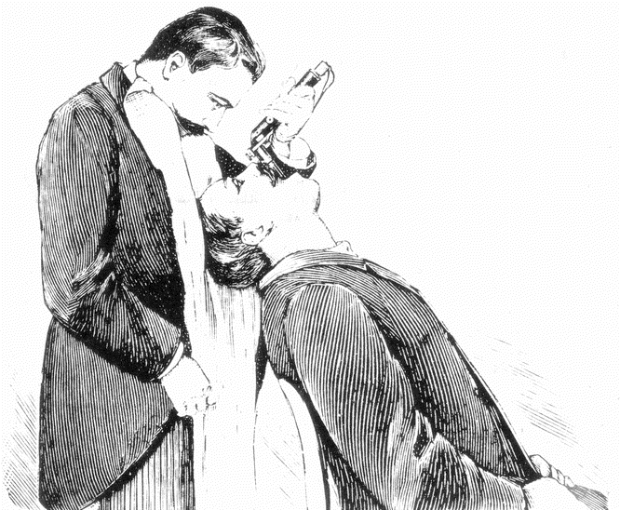
Approach to the ENT Exam
Dark spaces, seldom seen
Special tools
Moving Targets (often!)

Slide 4
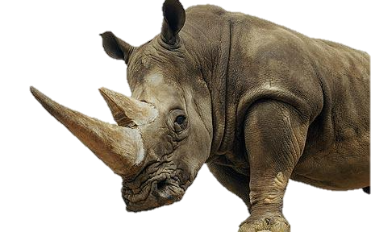
Nose
Down another dark hole (or 2)

Slide 5
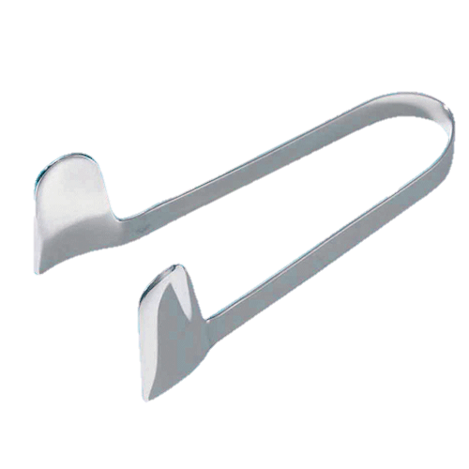
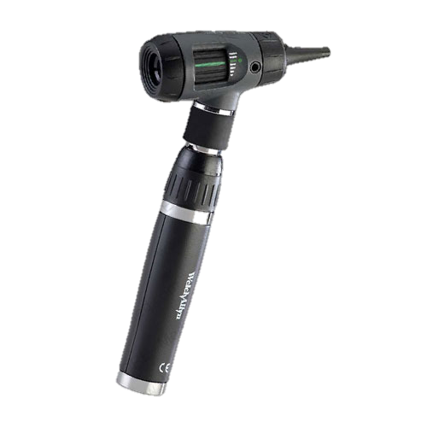
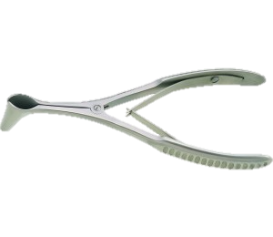
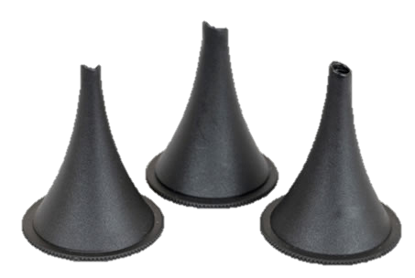
Nose - General
Equipment:
  Lighting
  Speculum
    ’Ear’ Speculum
    Nasal Speculum – e.g. Thudicum, Killian

Slide 6
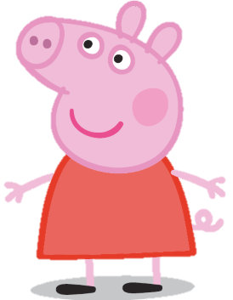
Nose - General
Tips:
  Positioning & Exposure
    Sit directly in front of patient
    Patient looking straight ahead +/- slight neck extension (if using ‘ear’ speculum)
    Adult: some form of nasal speculum (See right)
    Child: can see significant amounts with manual nasal tip Elevation “Peppa Pig”
Holding the speculum:
  ‘Ear’ Speculum:
    Place largest comfortable speculum into patient’s nostril
    Insert speculum fully along the nasal floor
    Pan the speculum superiorly to view the entire nasal cavity
  Killian Speculum:
    Hold in your non-dominant hand
    Place, closed, into nasal vestibule.
    Aim towards level of ipsilateral EAC, along the nasal floor
    Brace your speculum hand against some part of patient’s face – e.g. Nasal alar. Cheek, forehead.
    Once in position: Open the speculum
    Pan-up, Pan-down
TIPS
    DO insert the ’nasal’ speculum all the way into the nasal cavity to maximise view.
✔️

Slide 7
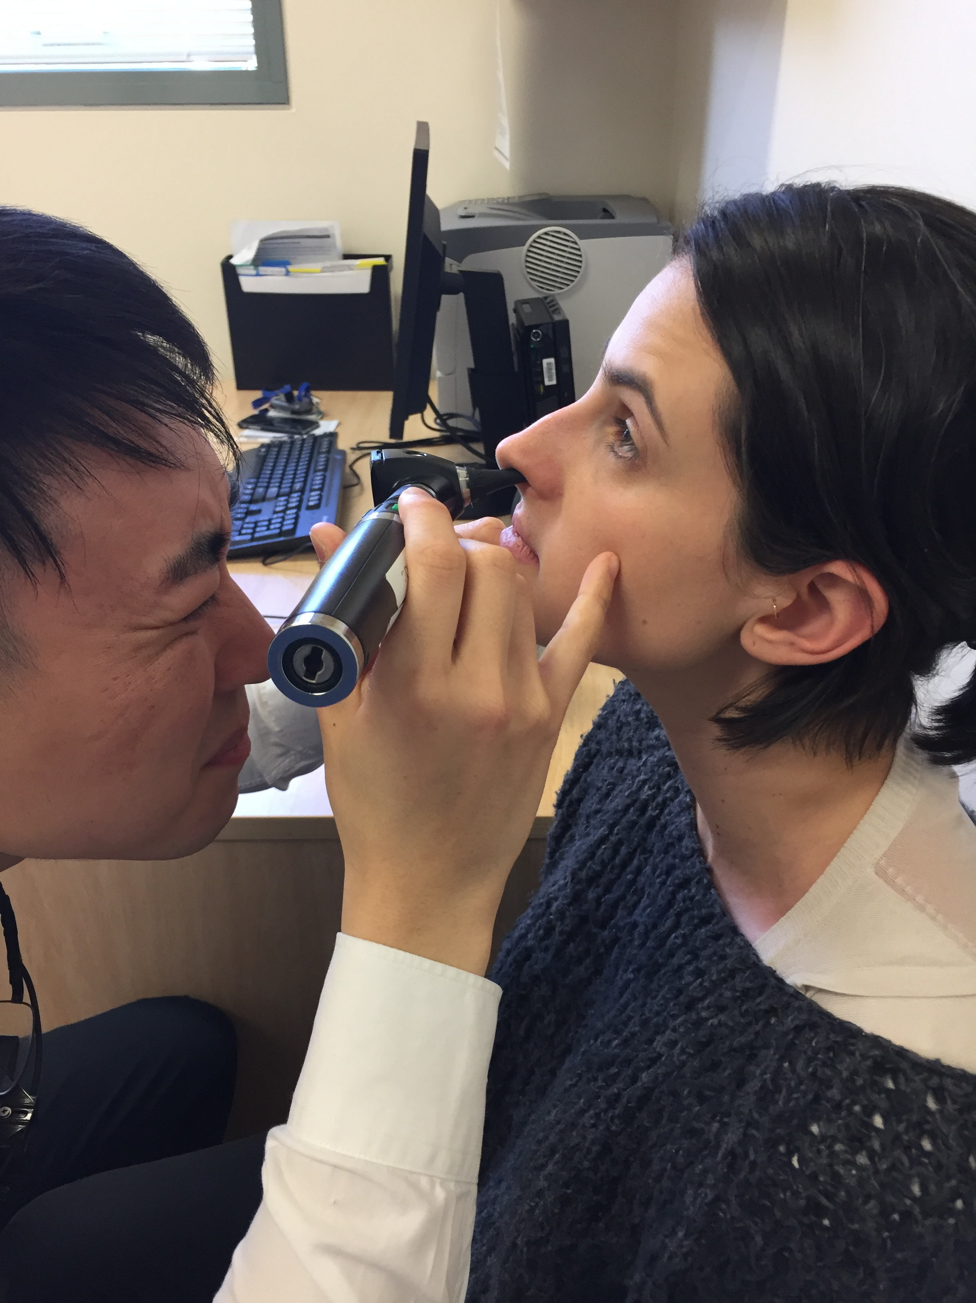
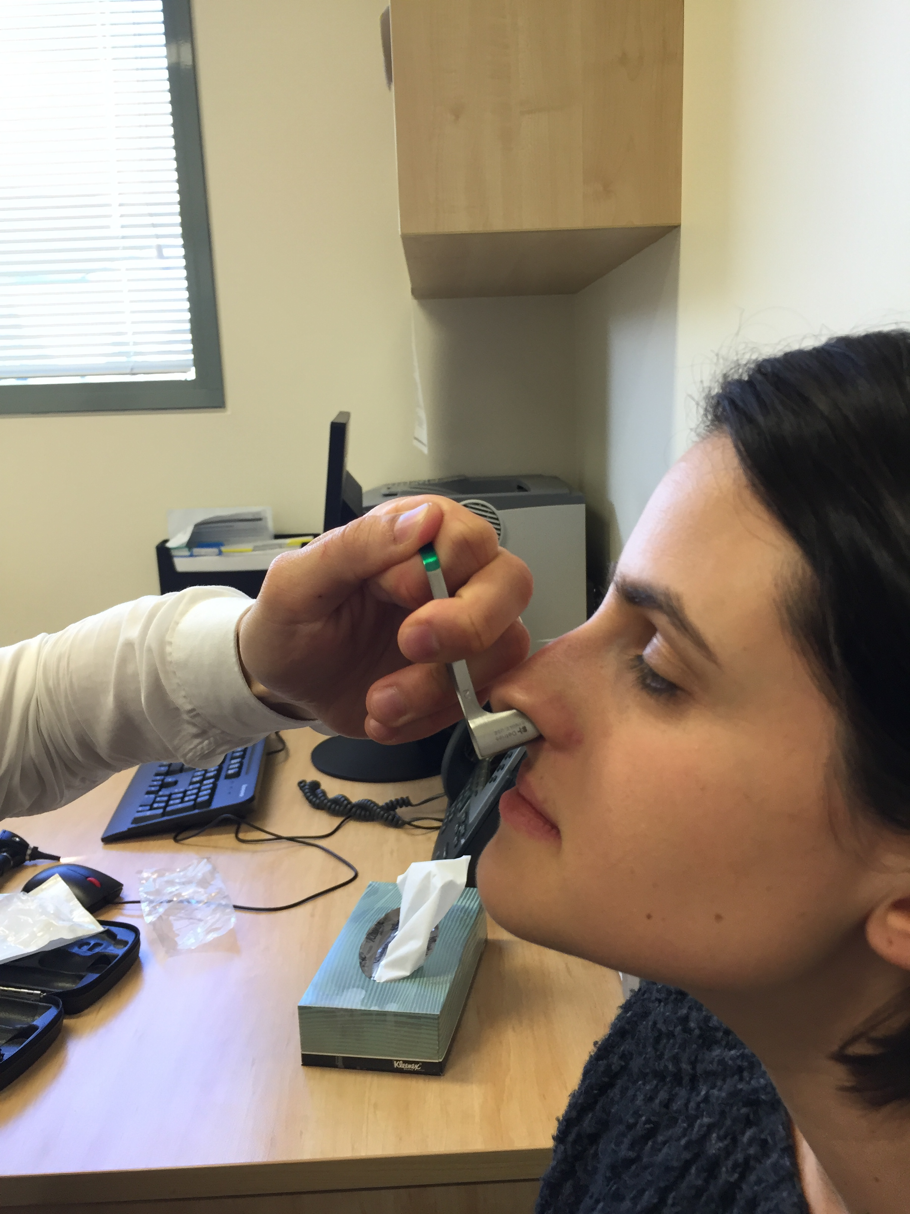
Nose - General
‘Ear’ Speculum
‘Nasal’ Speculum

Slide 8
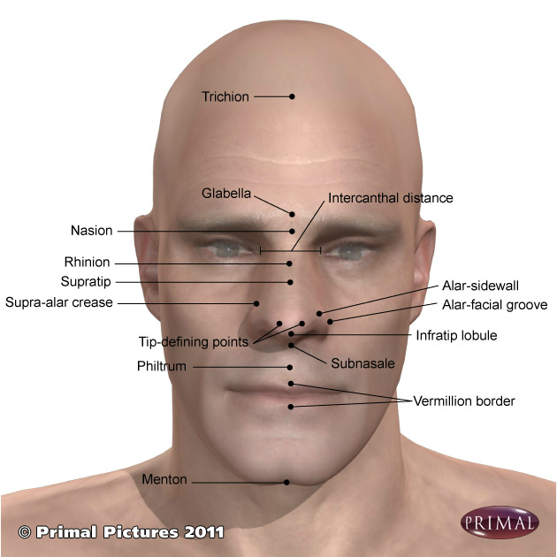
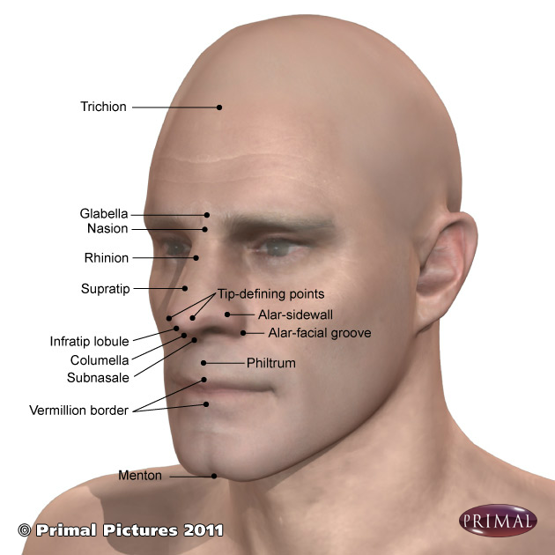
Nose - Anatomy
External Nose - Anterior
External Nose – Antero-Lateral

Slide 9
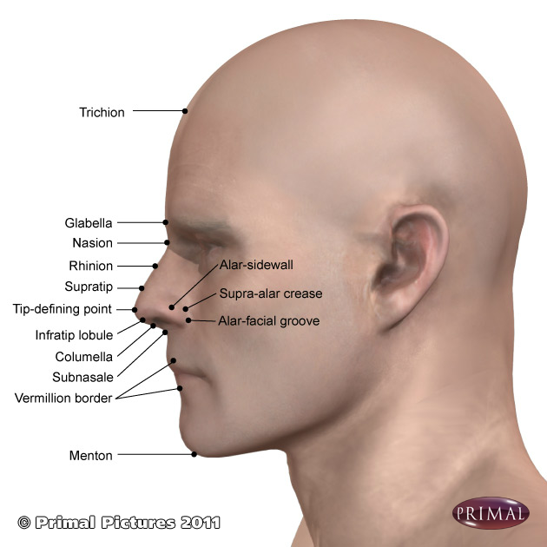
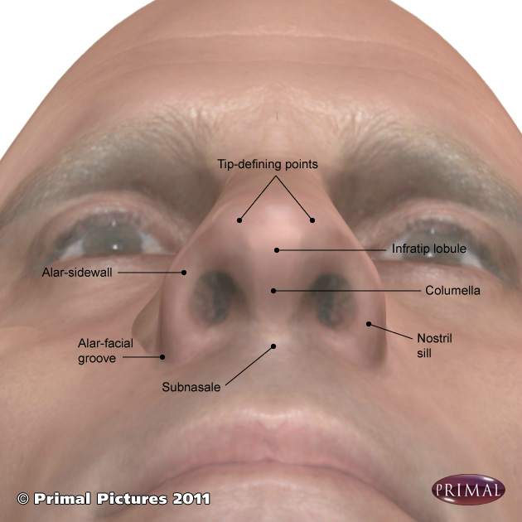
Nose - Anatomy
External Nose - Lateral
External Nose - Lateral

Slide 10
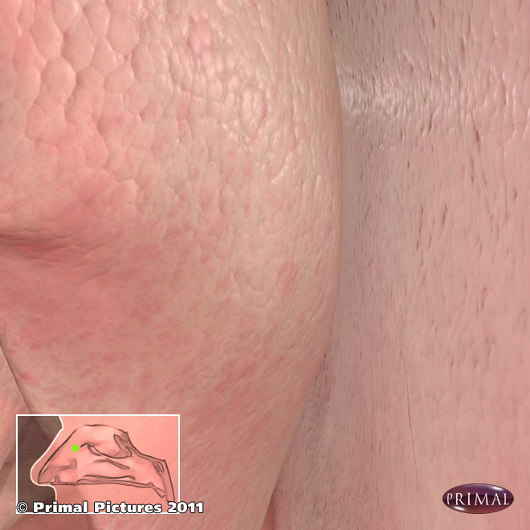
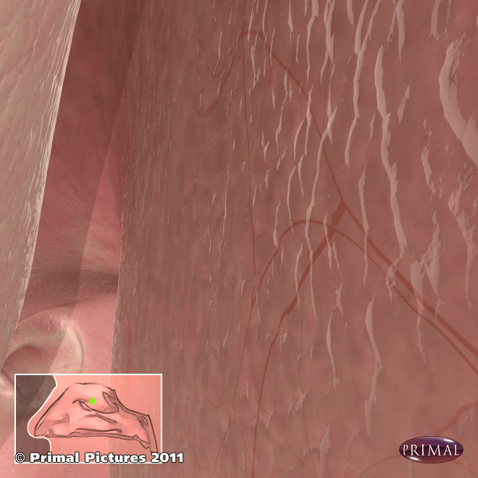
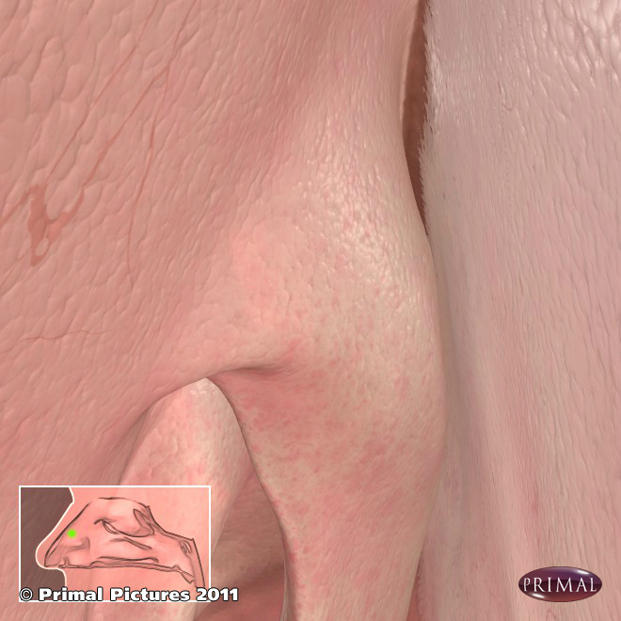
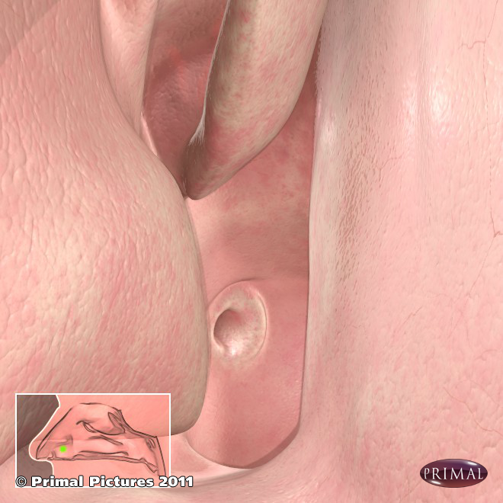
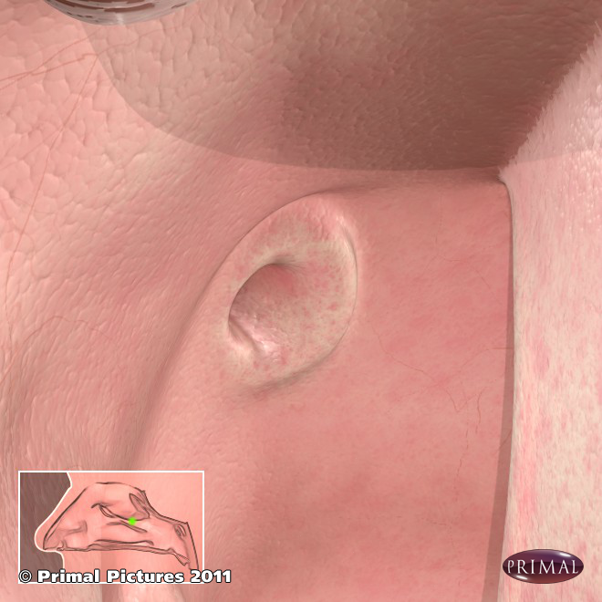
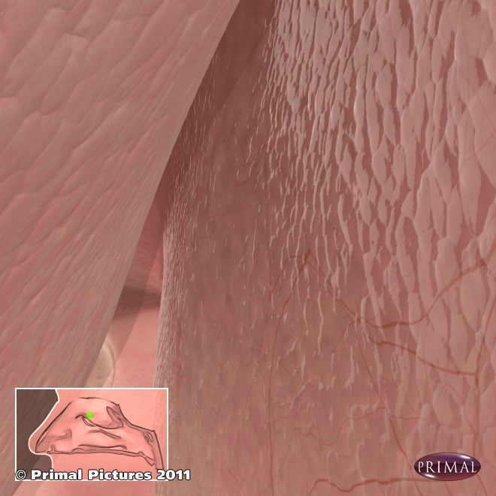
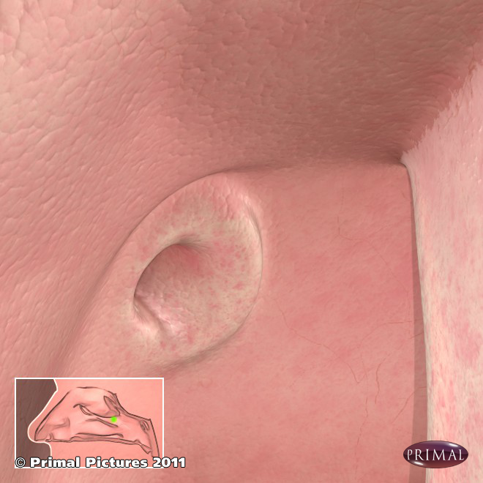
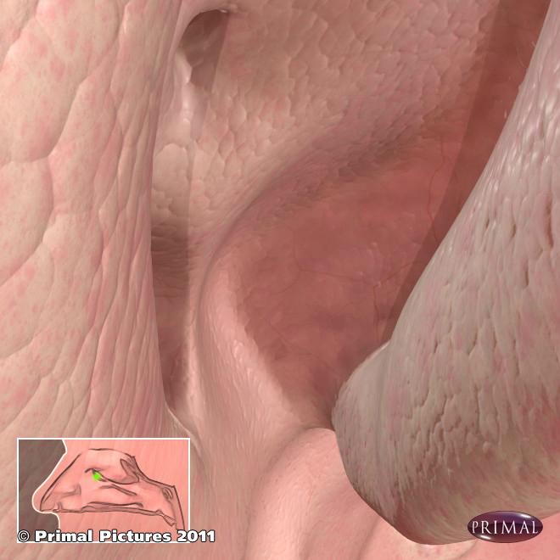
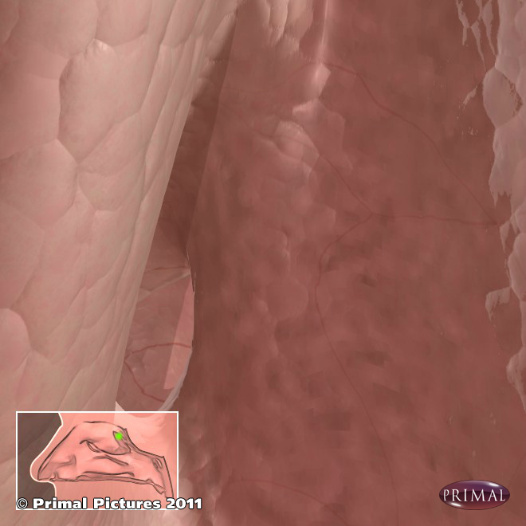
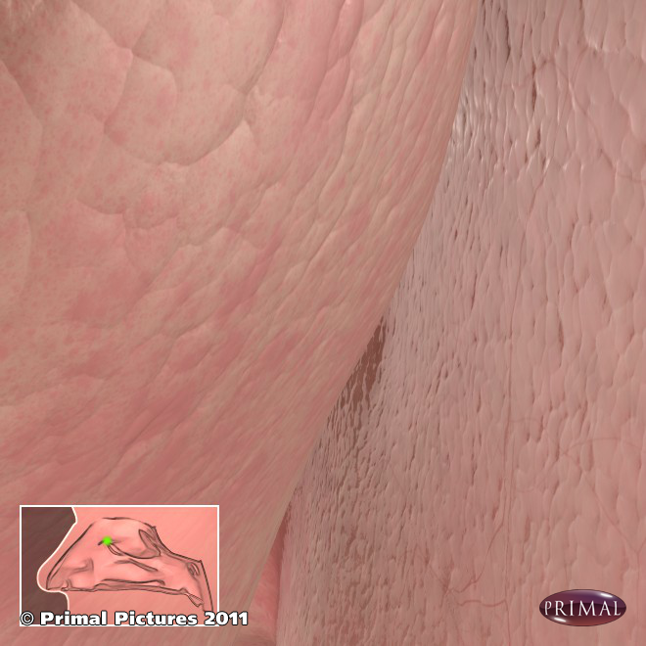
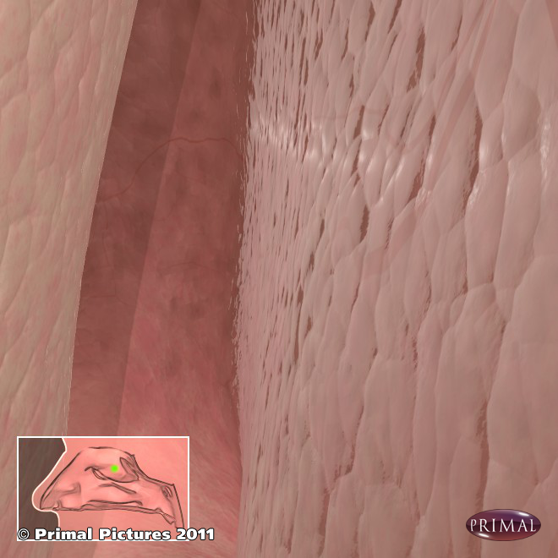
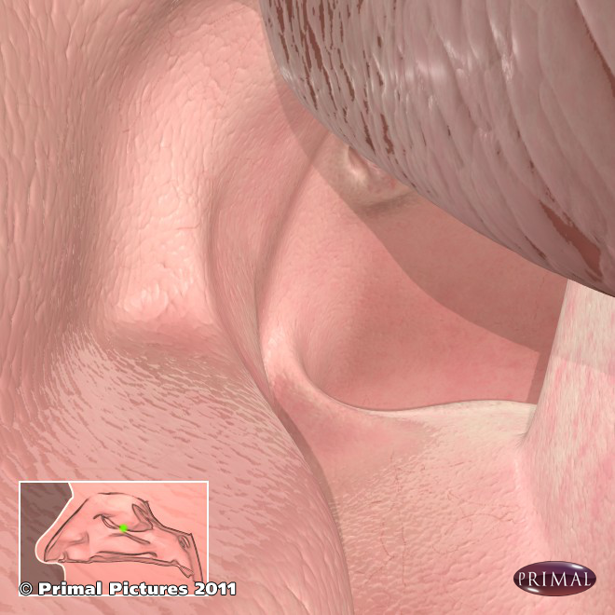
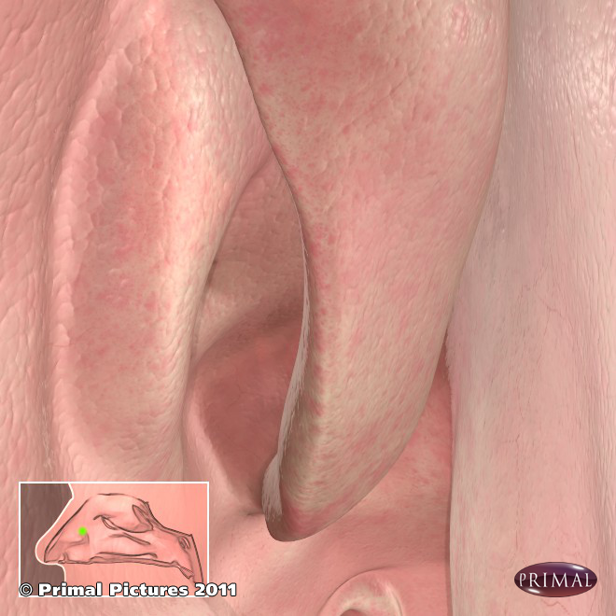
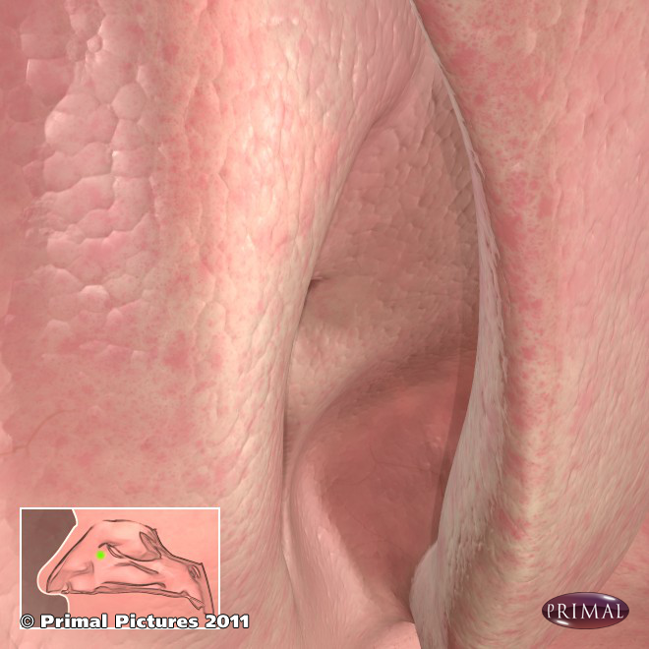
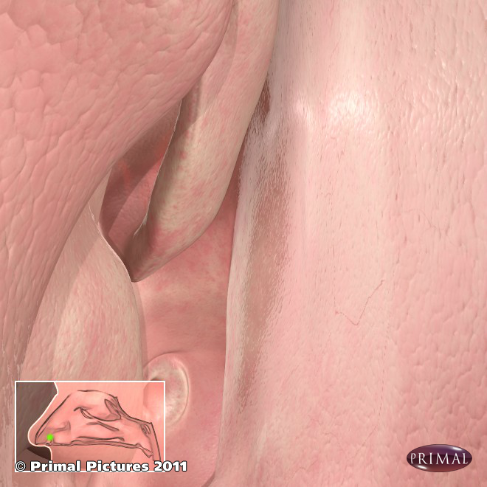
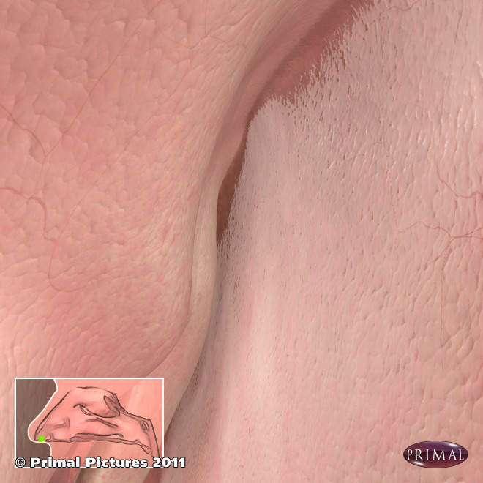
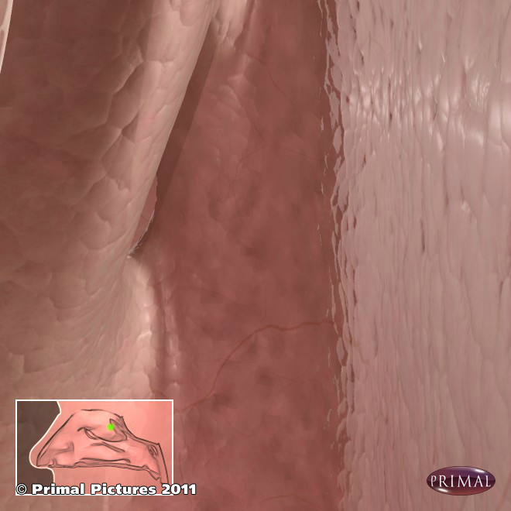
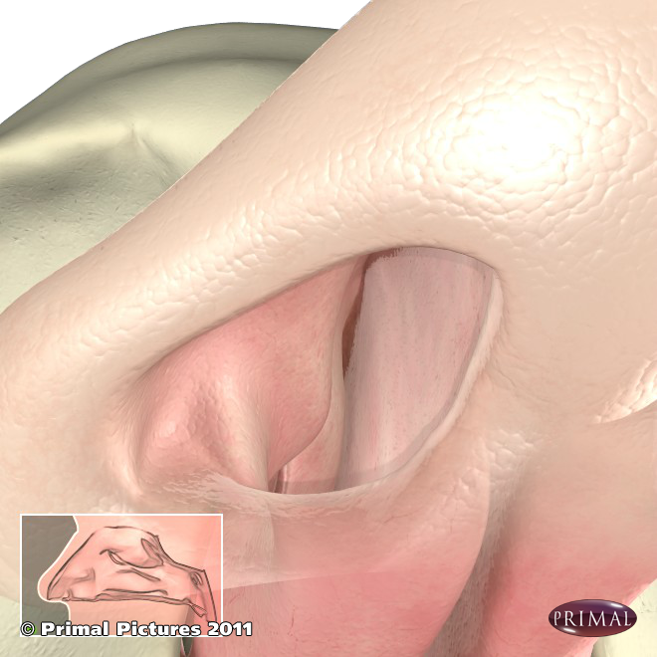
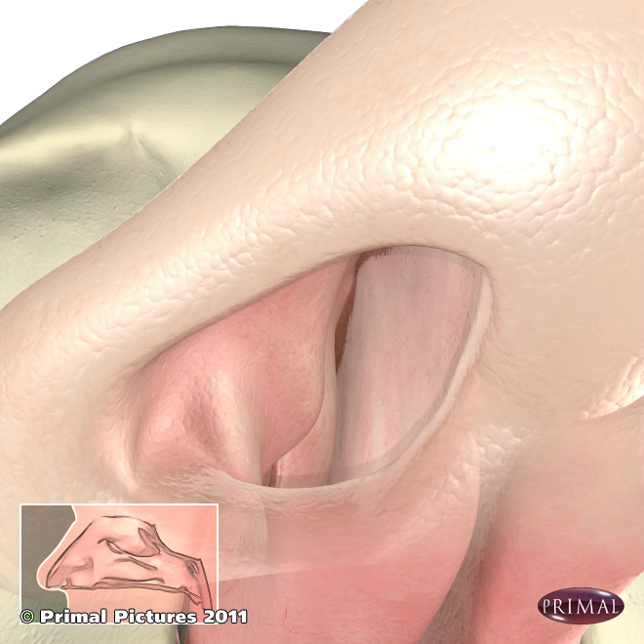
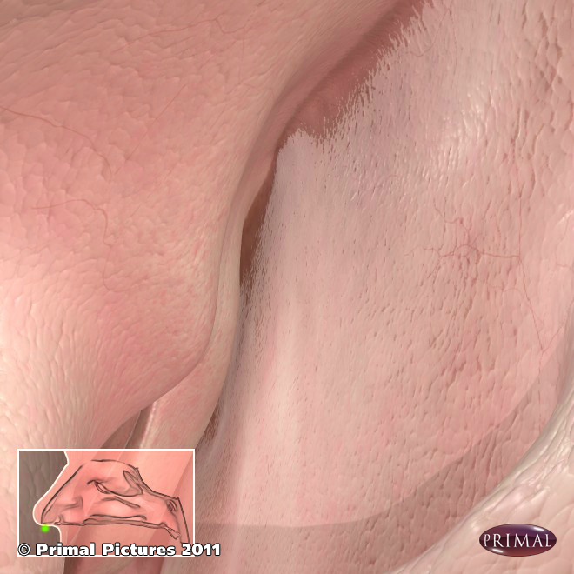
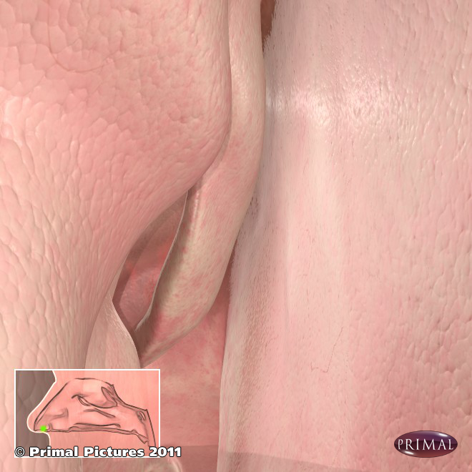
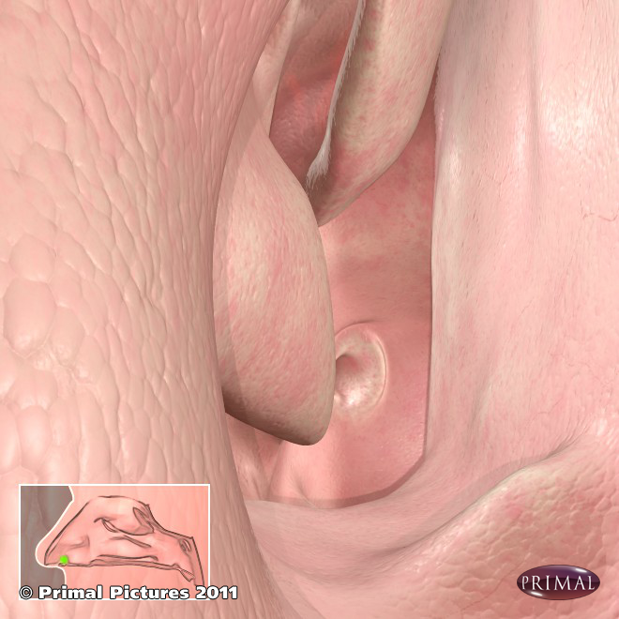
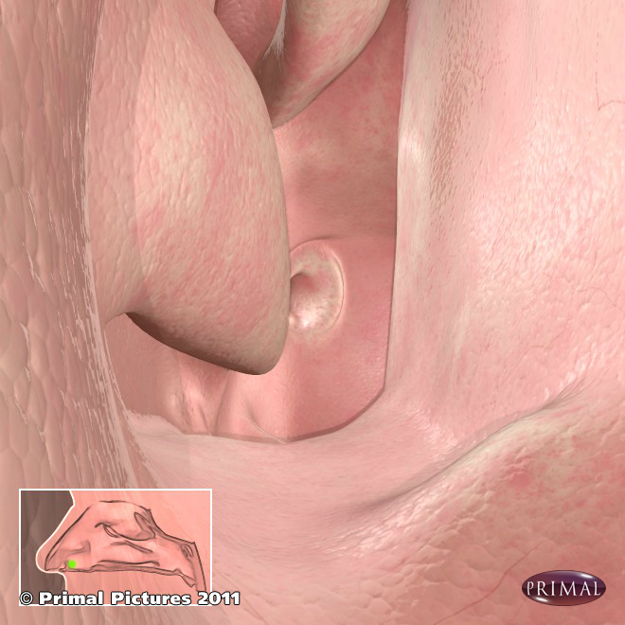
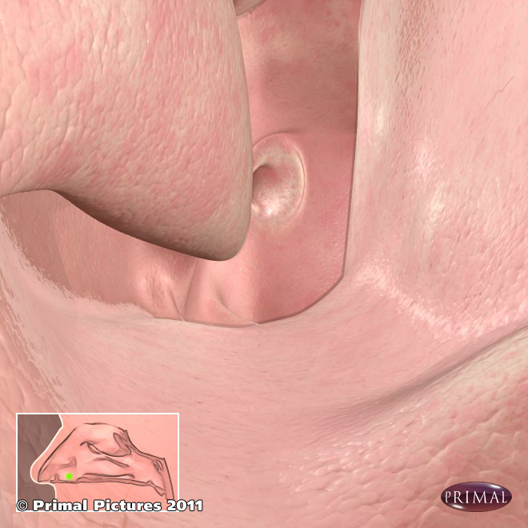
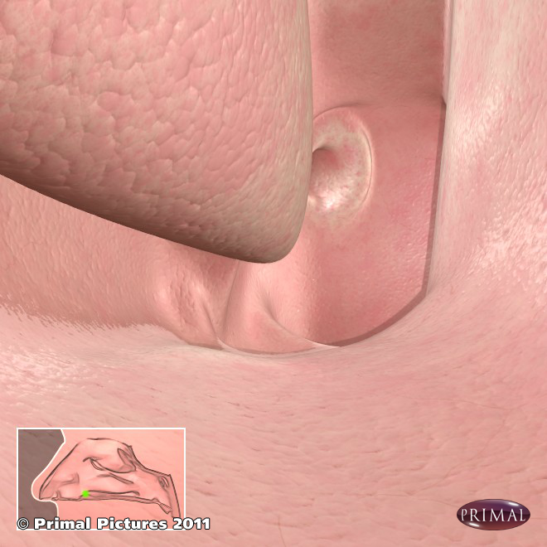
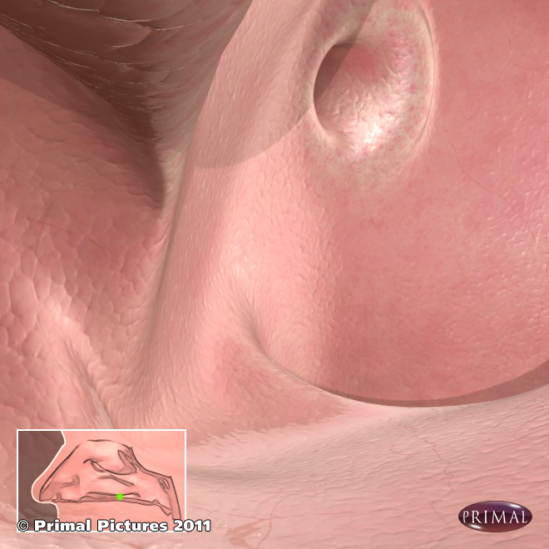
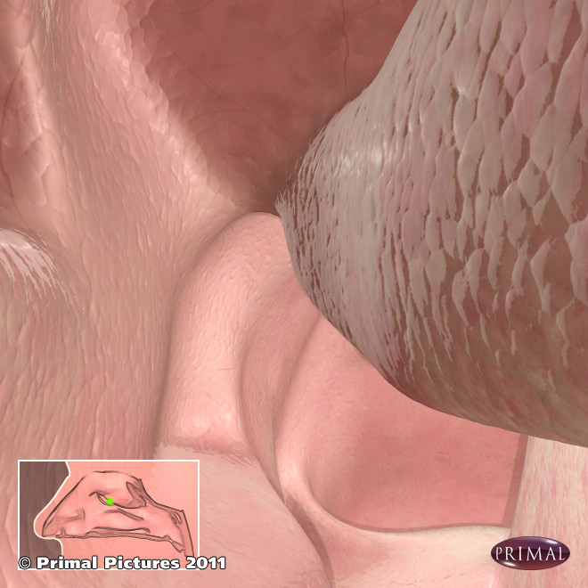
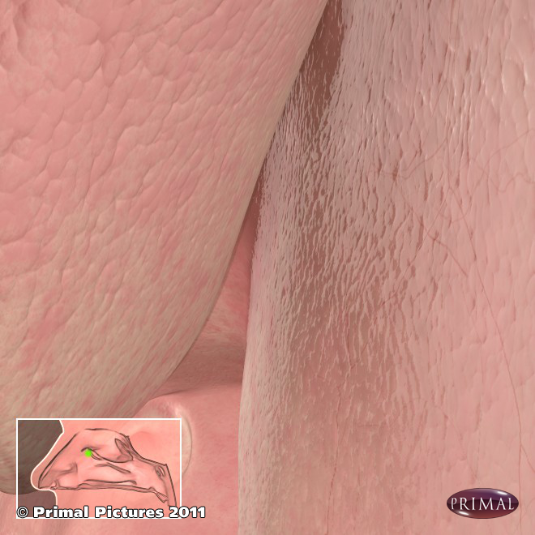
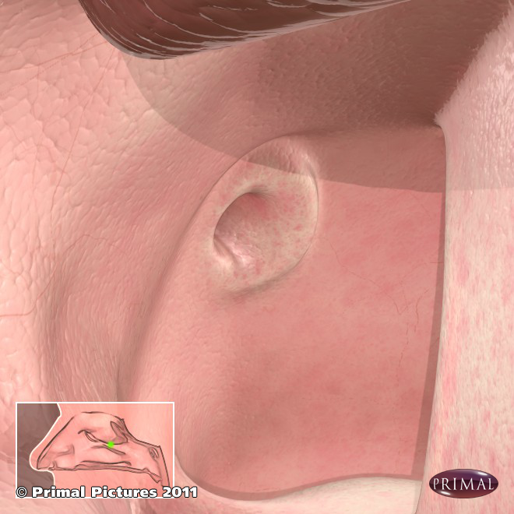
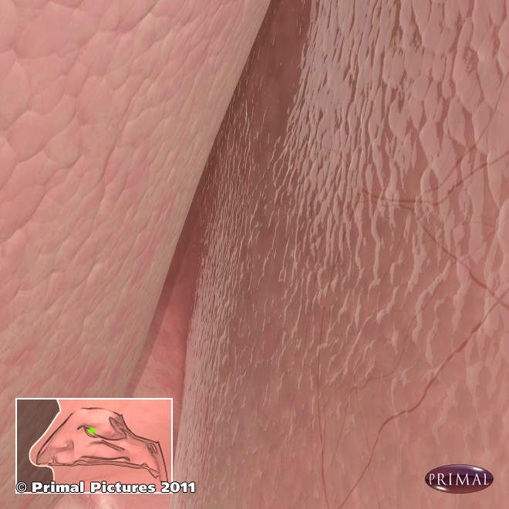
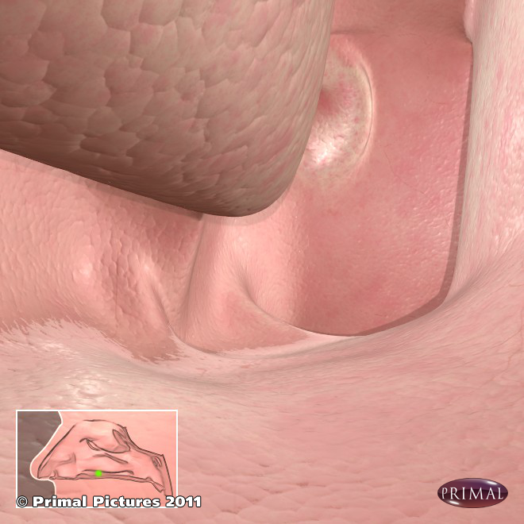
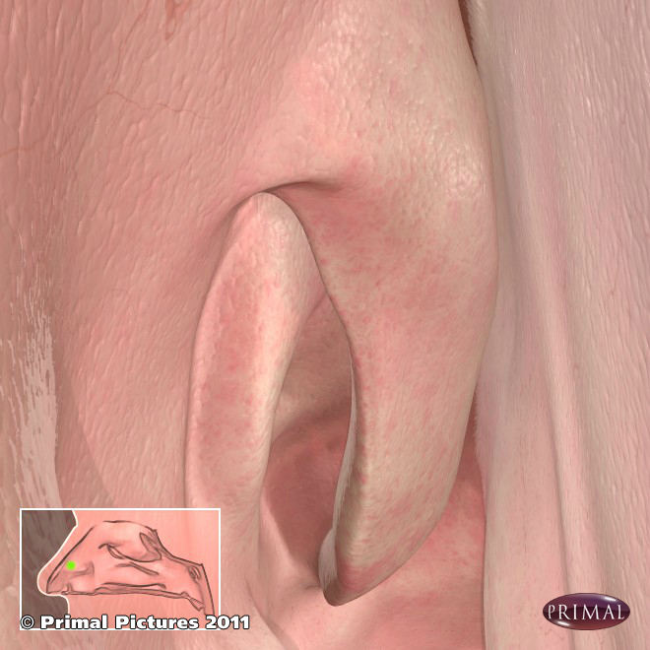
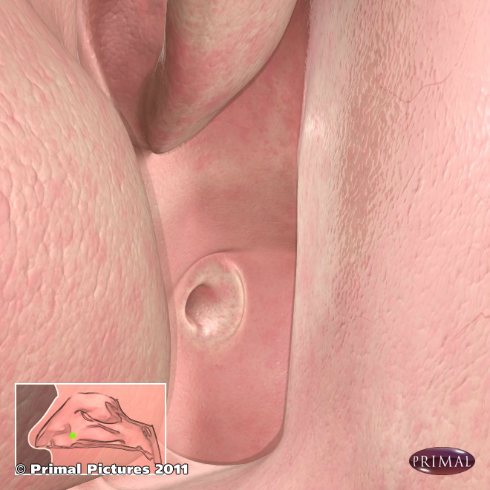
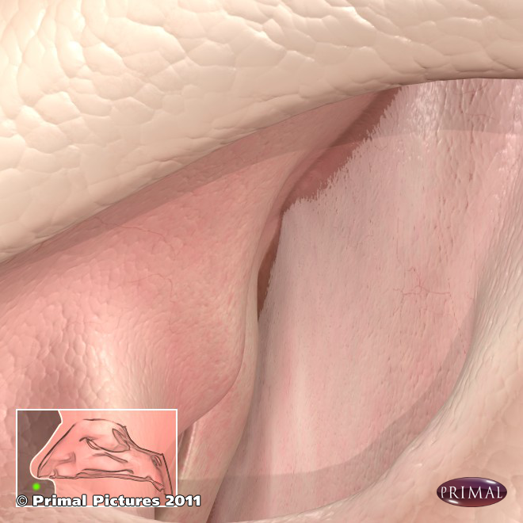
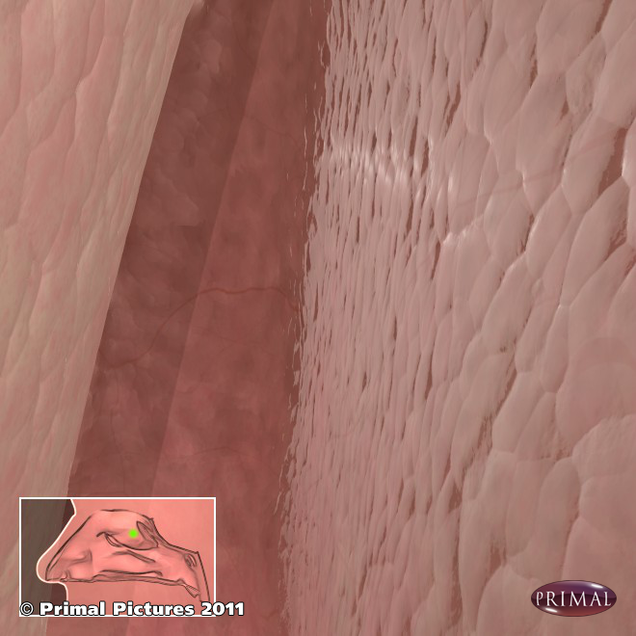

Nose - Anatomy

Slide 11

Nose - Anatomy

Slide 12


Nose - Functional
Inspection/Palpation
  External Nose
    External Deformity & Scars – e.g. Allergic Salute
    Lift Nasal tip:
      Vestibule/nasal valve: Incisions / lesions / deviations
      Columellar dislocation
      Rhinorrhoea: Colour / consistency
  Face
    Peri-orbital congestion
    Palpate sinuses
      Maxillary
      Anterior Ethmoidal
      Frontal

Slide 13
Nose - Functional
Inspection – Gross nasal polyposis
Anterior Rhinoscopy

Slide 14

Nose - Functional
Anterior Rhinoscopy
  Septum – e.g. Deviation
  Turbinates – e.g. Hypertrophy
  Mucosa – e.g. Allergic
  Pathology – e.g. Polyps, ulcers, mucous, masses

Slide 15
Nose – Anterior Rhinoscopy
Anterior Rhinoscopy - Allergic Rhinitis
Anterior Rhinoscopy - Polyposis
Polyps
Inferior
Turbinate
Inferior
Turbinate
Septum
Septum

Slide 16
Nose – Anterior Rhinoscopy
Anterior Rhinoscopy – Granular Mucosa
Anterior Rhinoscopy – Dry Mucosa

Slide 17
Nose – Anterior Rhinoscopy
Anterior Rhinoscopy – Normal Middle Meatus
Anterior Rhinoscopy – Allergic Mucin
Anterior Rhinoscopy – Purulent Discharge
Lateral Nasal Wall
Middle Turbinate
Septum
Maxillary Sinus

Slide 18

Nose - Functional
If Mass found
  Facial Numbness – infra-orbital n.
  Eye – proptosis, visual acuity, Horner’s
  Hard Palate – erosion, fistula
  Ears - effusion
  Regional Cranial Nerves - CN V, CN III,IV,VI
  Cervical Lymph Nodes

Slide 19


Nose
Functional Tests:
  Airflow –
    Nasal misting of a metal tongue depressor,
    Sniff test
    Response to nasal decongestants
  Olfaction
    Generic Fragrances
    Specific Smell Test kits

Slide 20
Thank You - Questions

